Slide 1
Tutorial 4: JavaScript
CS 104
Spring, 2024-25
TA: Abhi Jain
Credits: TA-2023-2: Guramrit Singh

Slide 2
Topics
JavaScript (Basics)
Fun Activities

Slide 3
JavaScript (Basics)
Functions
Iterables
Events

Slide 4
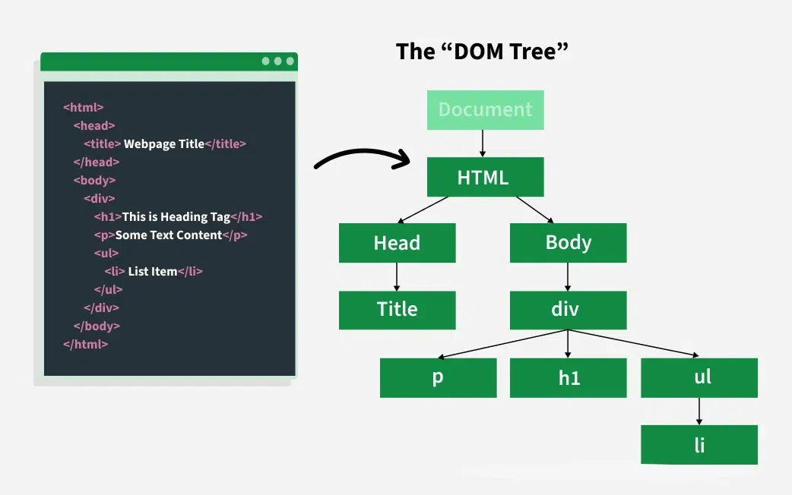

Slide 5
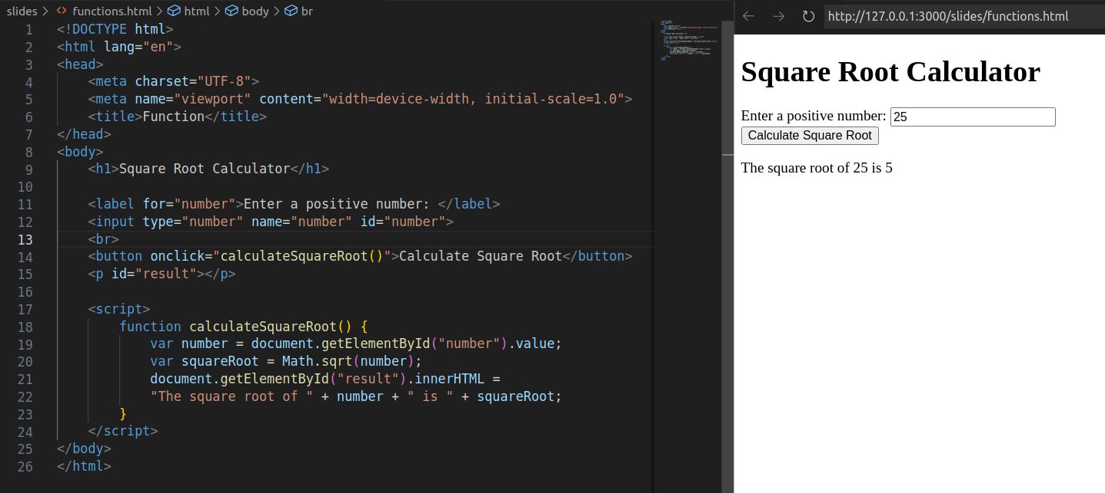
Functions
The getElementById() method is the DOM method that returns the element with the specified ID.
The innerHTML property is used to change the content of an HTML element.
The Math.sqrt() method is used to calculate the square root of a number.
The value property is used to get the value of an input element.
The document object represents the HTML document that is displayed in the browser.
The syntax of function is very similar to C++, except that we don't need to specify the return type of the function. The function keyword is used to define a function.
the onclick attribute is used to call the function when the button is clicked..

Slide 6
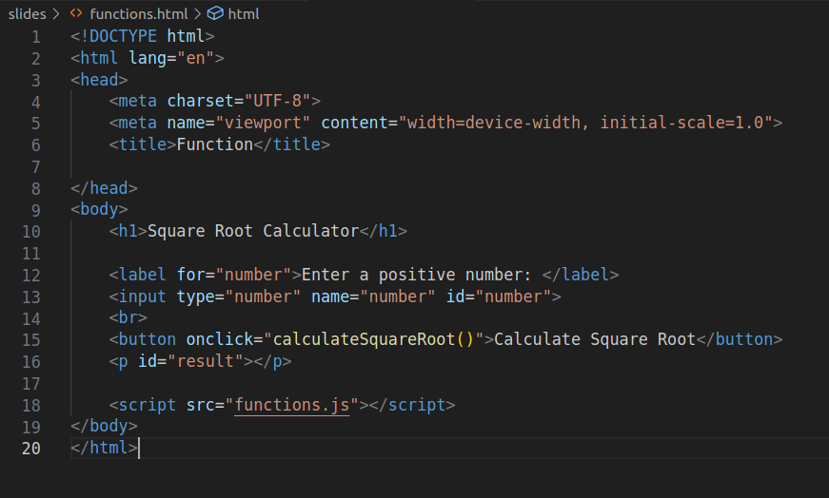
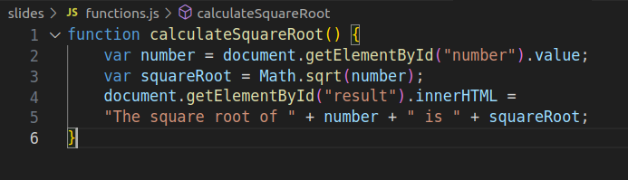
External Javascript
We do not use the link tag to link to external javascript files. We use the self-closing script tag instead.
It may be placed in the head or the body tag. The src attribute is used to specify the location of the external javascript file.

Slide 7
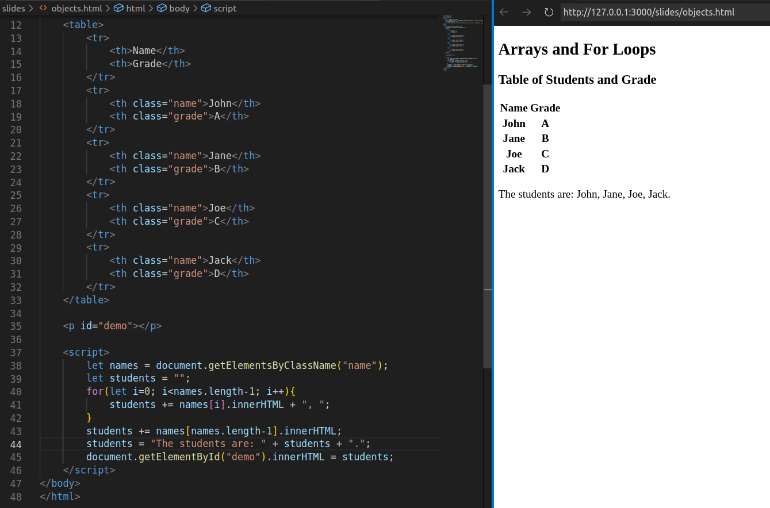
Arrays and Loops
getElementsByClassName() returns an array of objects with the same class name.
The for loop is used to iterate on an array of objects.

Slide 8
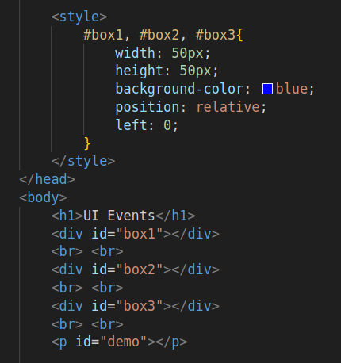
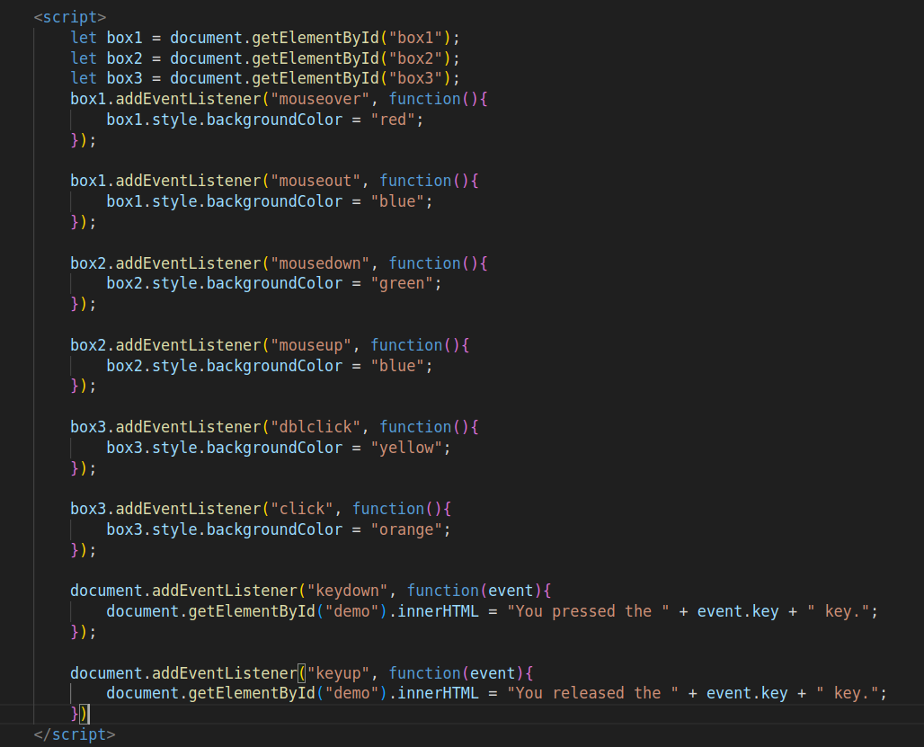
UI Events
Demo shown in tutorial session.

Slide 9
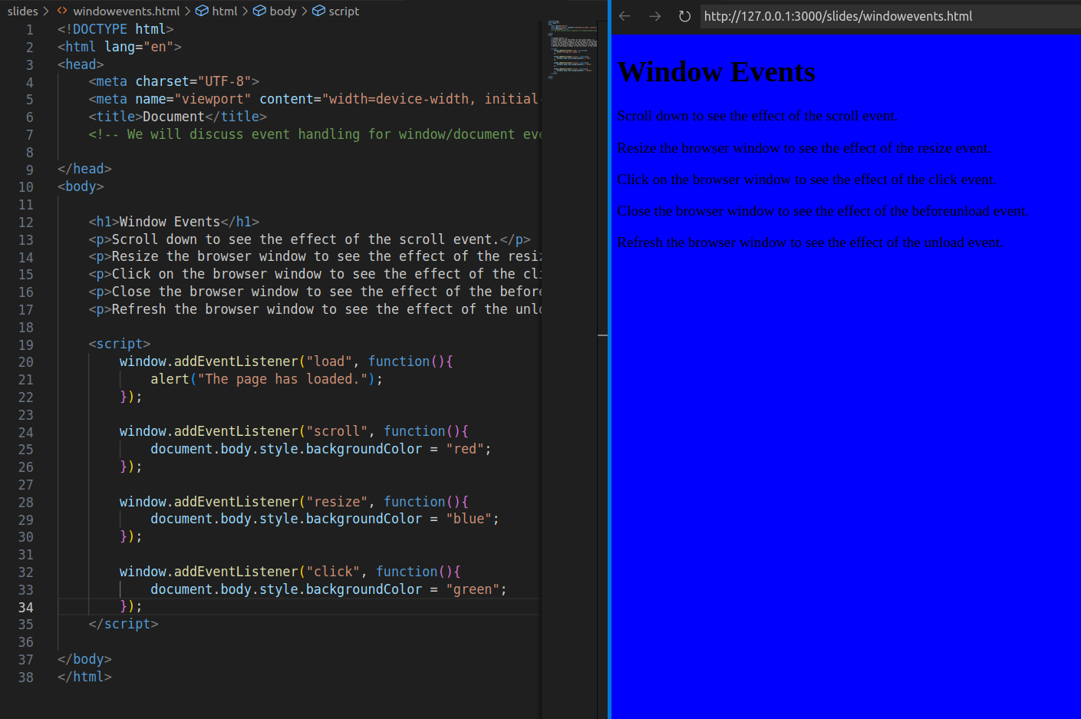
Window Events
Window events occur on the global window object and help track user interactions with the browser window.
Common Window Events:
- Load – Fires when the entire page has fully loaded.
- Scroll – Fires when the user scrolls the page.
- Resize – Fires when the browser window is resized.
- Click – Fires when the user clicks anywhere on the window.
Form Events:
Form events will be discussed in the Fun Activities section.

Slide 10
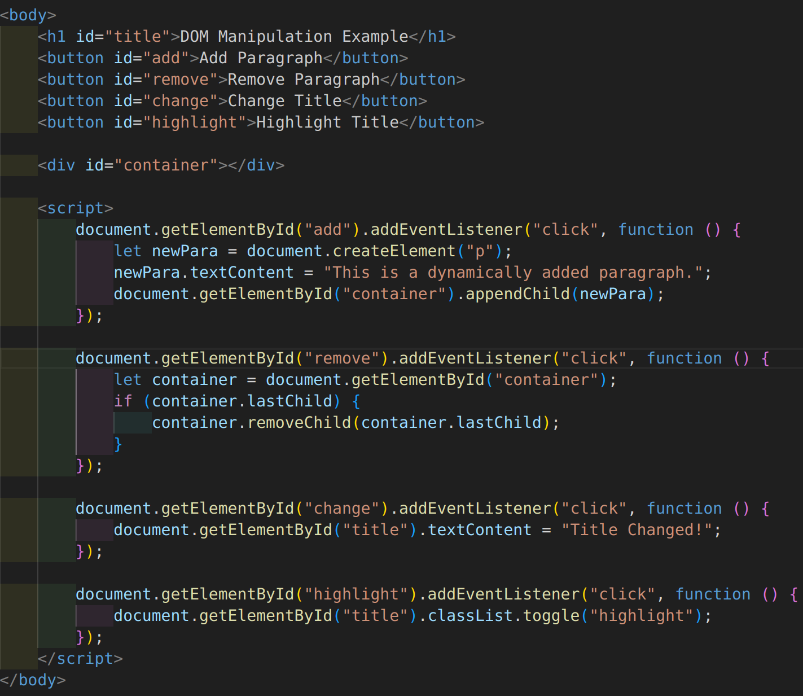
DOM Manipulation
document.createElement(tagName)
Creates a new HTML element.
appendChild(element)
Appends a child element to a parent.
removeChild(element)
Removes a child element from its parent.
element.remove() (Modern approach)
Removes the selected element itself.
setAttribute(name, value)
Sets an attribute to an element.
classList.add() and classList.remove()
Adds or removes CSS classes dynamically.

Slide 11
Fun Activities
Form Validation
Submission Handling
Your Own Carousel

Slide 12
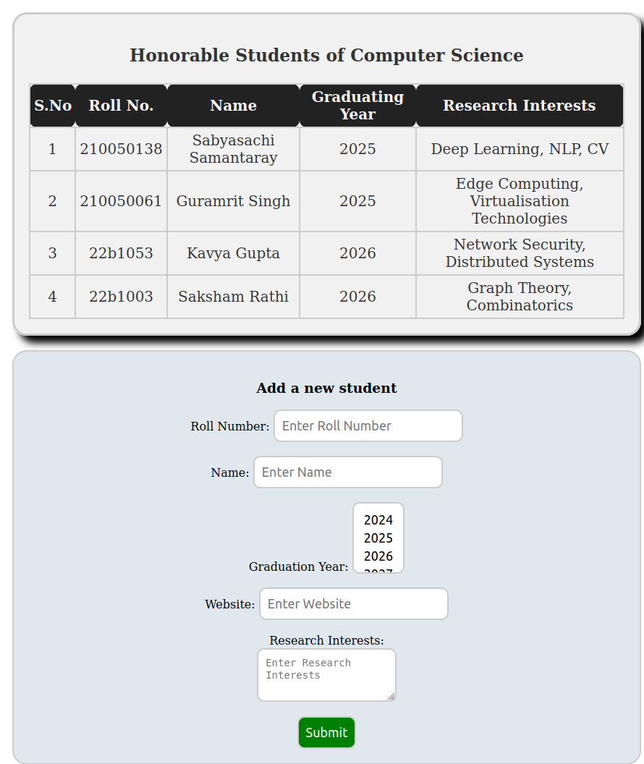
Activity 1 - Form Validation
In this activity, we will validate the entries in the form to be in a specific format(or in other words, obey a pattern or a regular expression)
When the form is submitted, the verifier is invoked which checks for correctness of the entries.
Remove all the required attributes we added to make the section compulsory. We instead do this verification in the submit_verifier itself.
The following functions may be of help:
.reset() for form resetting
alert() for popping up an alert window.
Solution: Provided as index_validate.html

Slide 13
Activity 1 - Hints
We shall follow the following simple checking rules:
Roll Number should be of Form YYBXXXX - where Y and X are digits
Name should contain letters and spaces. Ensure no two consecutive spaces, and no space at the end.
Research Interests and GradYear fields should not be empty.
You would have to write your own regular expression to verify/test the input. Refer here for ECMAScript(JavaScript) RegExp References.
To build and test Regular Expressions, check out this.

Slide 14
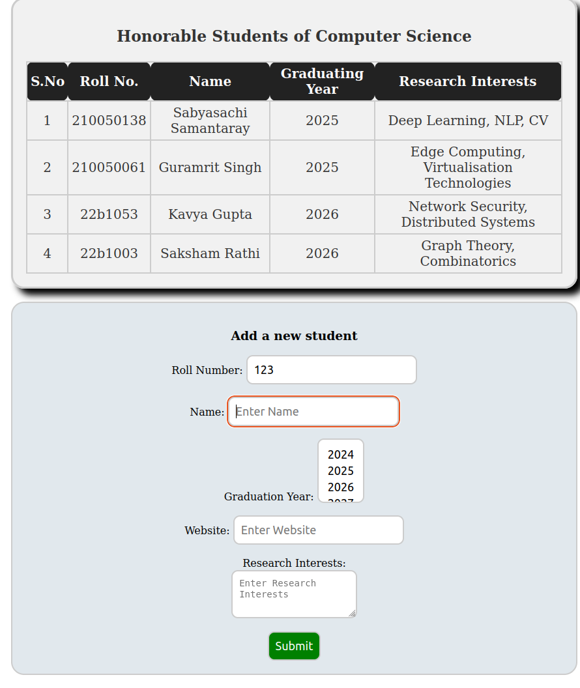
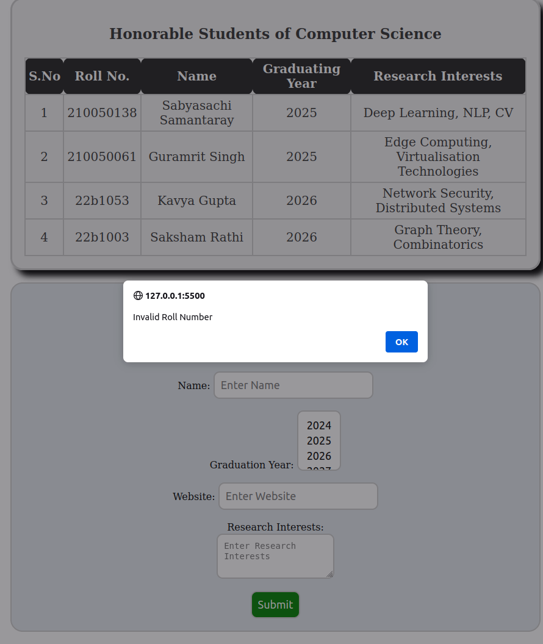
Activity 1 - Demo

Slide 15
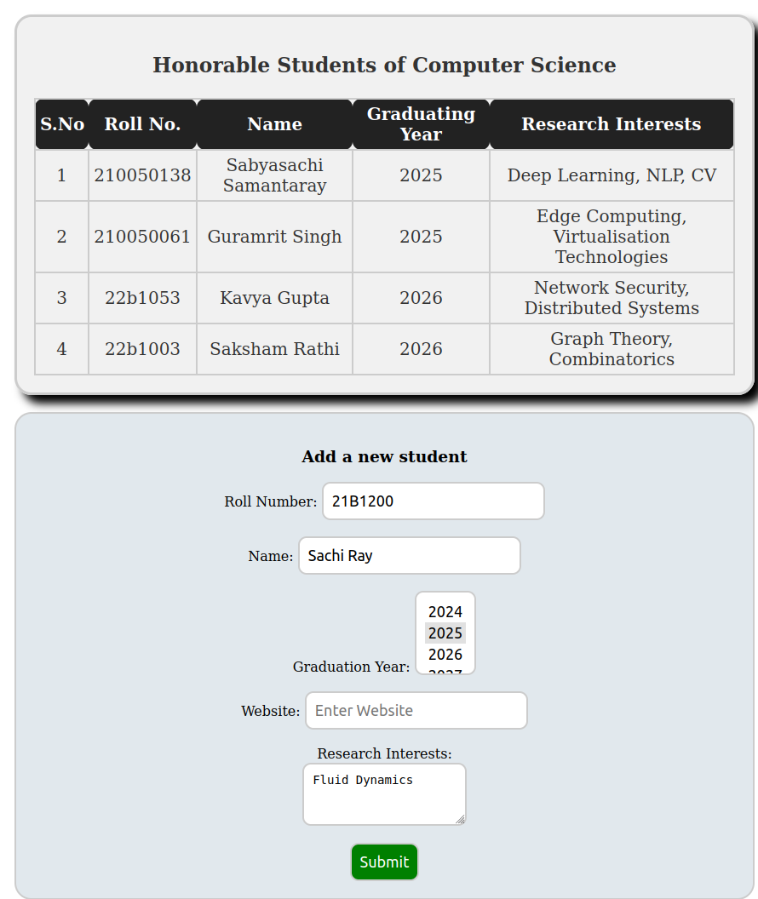
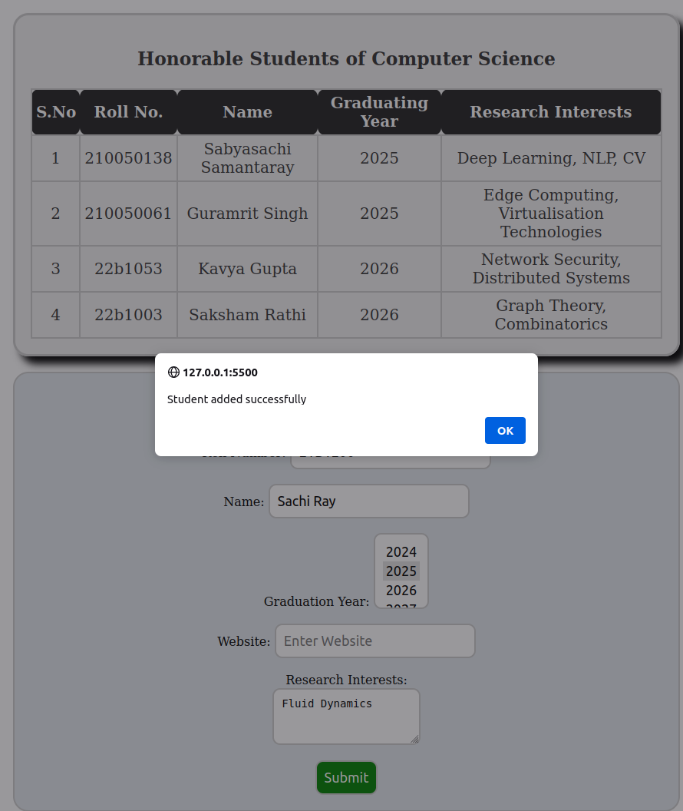
Activity 1 - Demo
Alert box shows that all information was correct
Resets the form

Slide 16
Activity 2 - Submission Handling
In this activity, we will be handling the submission of the add-student form created in the activity last week.
When the form is submitted, append the student information to the end of the table and reset the form after submitting.
Hints:
Disable the default form submission behavior.
The website input field is not mandatory.
Backtick character ` creates template literals which allow for multi-line strings and string interpolation.
Solution: Provided as index_submit.html

Slide 17
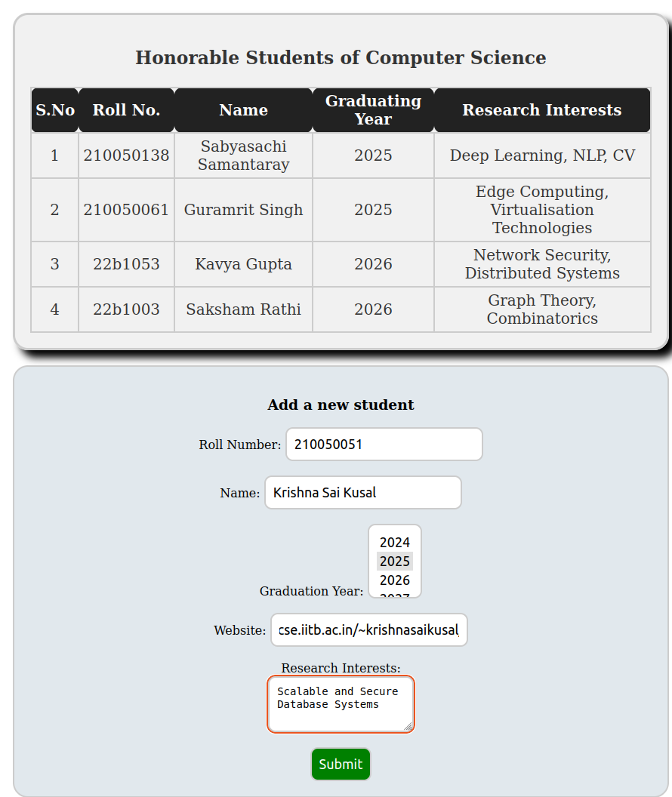
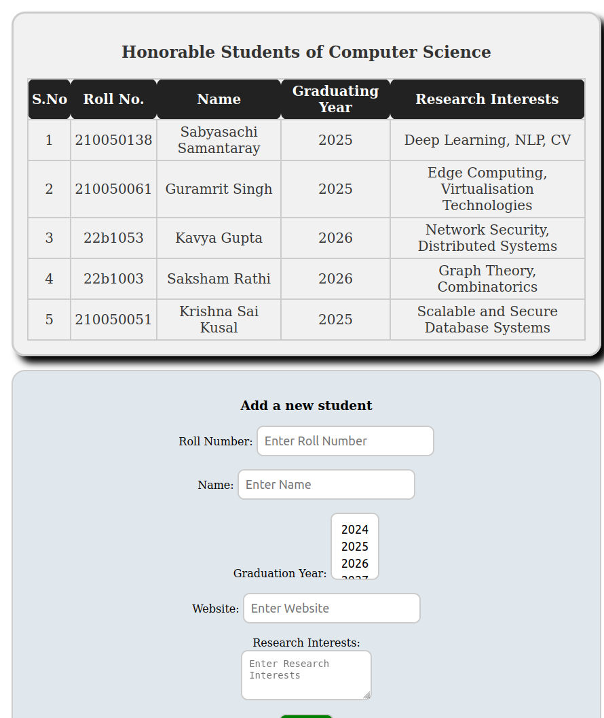
Activity 2 - Demo
Submit

Slide 18
Activity 3 - A Simple Carousel
Description:
The carousel will have 4 images and 2 buttons to navigate through the images.
The images will be displayed one at a time.
The buttons will be used to navigate to the next and previous images.
You shall ensure that there is a cyclic navigation i.e.
Next on the last image displays the first image
Previous on the first image displays the last image
In this activity, we will build a simple carousel/slideshow.
You can use the images provided in the resources section or use your own images.
You can use the Unicode Decimal Code for arrows to display the next and previous buttons.
Check out CSS Transitions.
HTML Code for Left Angle is &#10094; and for Right Angle is &#10095;
Solution: Provided as carousel.html

Slide 19

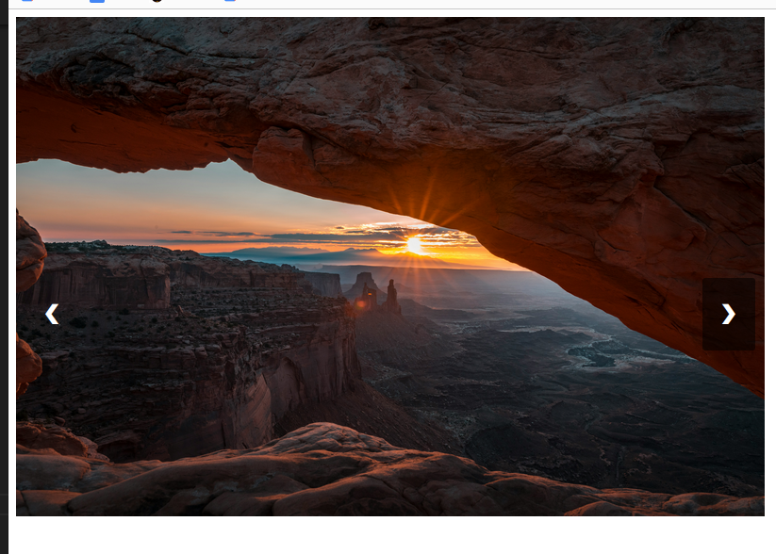


Activity 3 - Demo

Slide 20
Thank You !!!

